Slide 1
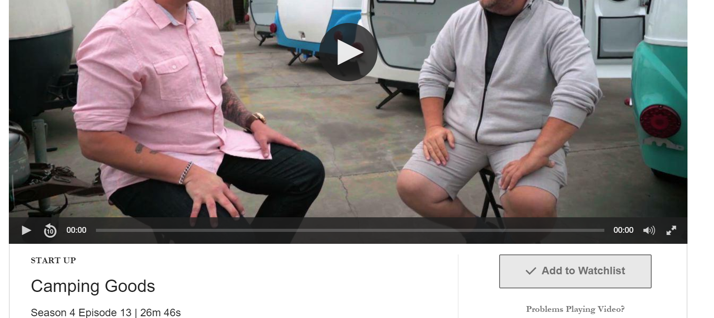
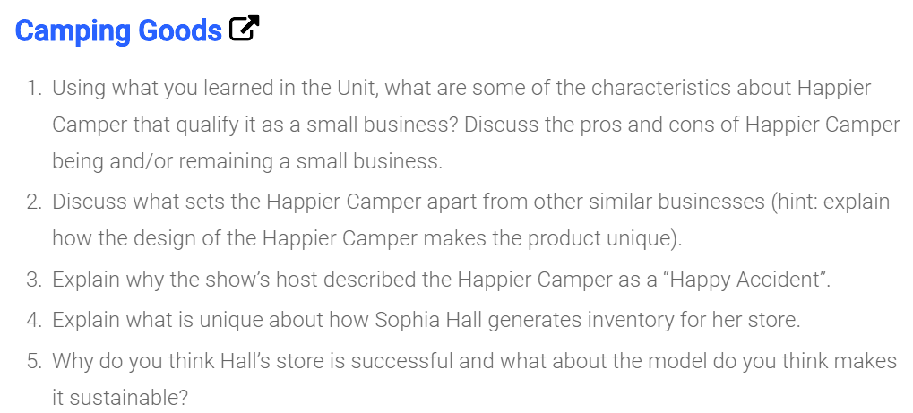

Slide 2



Slide 3

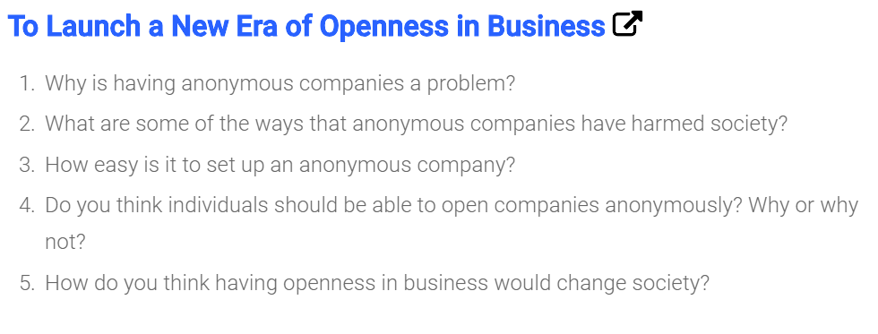

Slide 4
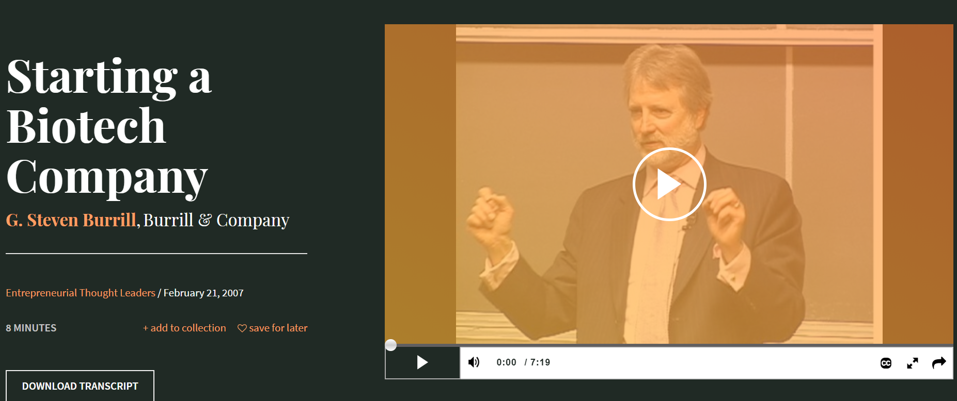


Slide 5
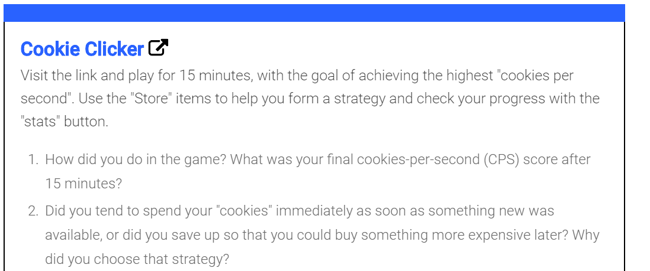

Slide 6
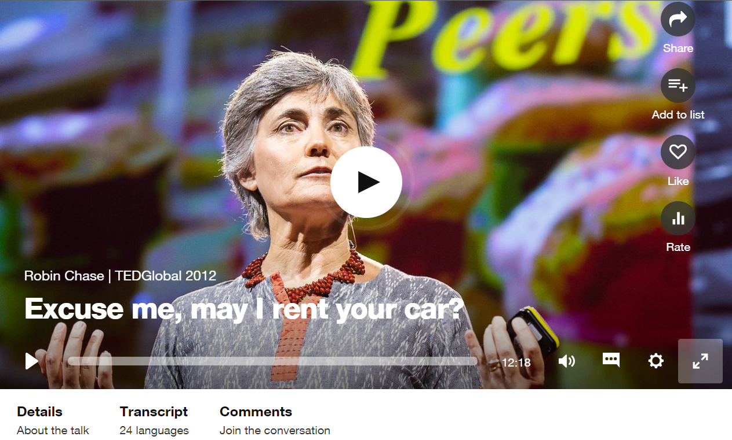
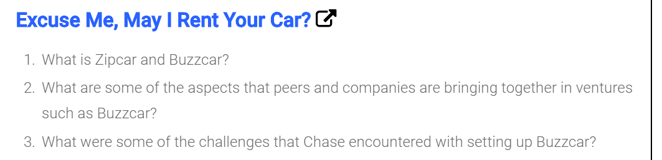

Slide 7

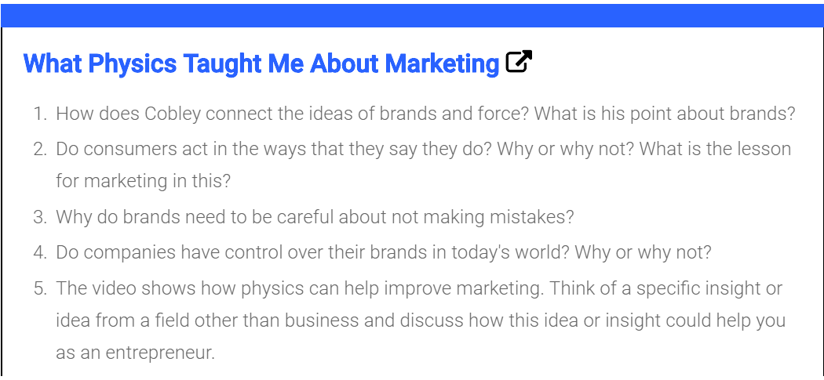

Slide 8



Slide 9
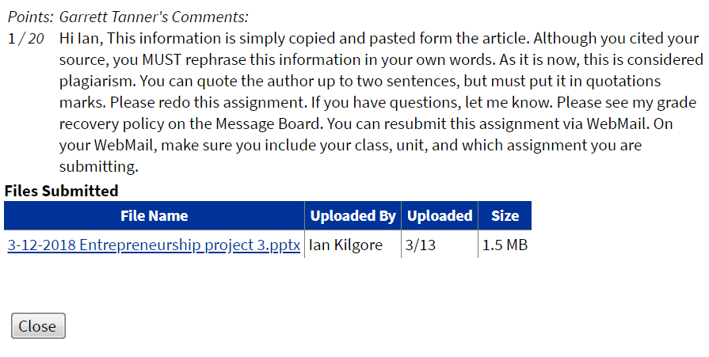
Points: Ian Kilgore’s comments:
1 / 20
Hi Garrett Tanner, The titles are simply copied and pasted from the video. Although you cited your source, you MUST rephrase the titles in your own words. As it is now, this is considered plagiarism. You can quote the author up to two sentences, but must put it in quotations marks. Please make your own creative title. If you have questions, let me know.

